Slide 1
CONCUR Travel and Expense Reimbursement
NEURODEVELOPMENT AND PSYCHOSIS SECTION Finance & Administration Team
Contact us: 10Admin-Fin@pennmedicine.upenn.edu

Slide 2

Penn Business Practices

Slide 3
Purchasing
PI/Delegate notifies @10Team of expense/event
(see next slide)
10Admin-Fin Team acknowledges w/n 24 hrs
Team notifies requestor; and vendor as needed
RECEIPTING
To release payment to a vendor/supplier, we need to know that you received the good/service as requested
PAYMENT VERIFICATION
Team confirms payment cleared; notifies requestor
Query for additional info as needed (i.e., bid-waiver; other approvals)
Provide transaction info, and/or request transaction confirmation if buyer is not direct receipient
Team initiates BUY w/n 24-96 hrs
Confirm best method of purchasing with requestor
Initiate transactions
PURCHASING METHODS:
Purchase Order (before/in advance)
Non-PO Payment Request
Purchasing Card (submit to Dept)
Direct Bill
Out-of-Pocket Reimbursement
Notes:
Some of the benefits of purchasing through Penn’s systems are the (1) tax exemptions and (2) volume purchasing=savings!
As much as it is possible, do not pay for things out-of-pocket. When you pay out-of-pocket, the University is under no obligation to reimburse you.
PURCHASING METHODS:
Purchase Order (before/in advance) – legally binding credit
Non-PO Payment Request – exactly what it reads as, when the PO cannot be issued
Purchasing Card (submit to Dept) – up to $1000/transaction; highly recommend for registration fees; does not replace the PO…if a vendor takes a PO, then we issue a PO.
Direct Bill – internal payments processed using the budget code.
Out-of-Pocket Reimbursement – when all other methods do not apply. Taxes are not reimbursed unless it is part of an approved travel expense.

Slide 4
Purchasing Methods
Purchase Order (before/in advance)
Non-PO Payment Request
Purchasing Card (submit to Dept)
Direct Bill
(internal)
Out-of-Pocket Reimburse-ment
CONCUR
Notes:
PURCHASING METHODS:
Purchase Order (before/in advance) – legally binding credit.
Non-PO Payment Request – exactly what it reads as, when the PO cannot be issued.
Purchasing Card (submit to Dept) – up to $1000/transaction; highly recommend for registration fees. The P-Card does not replace the PO…if a vendor takes a PO, then we issue a PO.
Direct Bill – internal payments processed using the budget code. Examples: poster printing at the Biomed Commons; airfare; service centers on campus.
Out-of-Pocket Reimbursement – when all other methods do not apply. Taxes are not reimbursed unless it is part of an approved travel expense.
Penn requires that we use all other methods before there is an out-of-pocket expense to be reimbursed. That is why it is last!
For travel accommodations and ground transport, and meals while traveling on Penn Business, those costs cannot be prepaid.
You are required to submit your travel expense report (TER) within 2 weeks of returning from said travel.
The 182-day limit…just don’t even chance it. (In EXCEPTIONALLY RARE circumstances, you may have an expense older than 182-days. In those cases, the requester must send a memo to the Department’s CFO/COO with supporting documentation and reason for not processing before 182-days. It is at the full discretion of the DEPT and SCHOOL to approve or reject. If you are approved, this reimbursement is paid as an additional pay and not through Concur.

Slide 5
How to communicate your purchasing need
PI/Acct owner sends an email to 10Admin-Fin@
with these 5 pieces of info:
Acct to charge: 400-4###-#-######-xxxx-####-#### [insert “fund” nickname]
Business Purpose: [If it is being paid by a grant, state how it is required for the project.]
Delivery Address: “Penn” campus location
Total Amount: $$$$
Attachment(s): [Quotes, invoices, or a “shopping list” from an approved Penn supplier.]
Examples:
Accepted manuscript; peer-reviewed publication fee. [Insert full citation.]
[Insert full conference name] registration fee to present study findings.
Postage to send mailers to study participants.
Notes:
The PI/Acct owner sends an email to our team at 10Admin-Fin@ with these 5 pieces of info:
Acct to charge: 400-4###-#-######-xxxx-####-#### [insert “fund” nickname]
*Business Purpose: [If it is for a grant, state how it is required for the project.]
Delivery Address: “Penn” campus location
Total Amount: $$$$
Attachment(s): [Quotes, invoices, or a “shopping list” from an approved Penn supplier.]
Examples of business purposes/justifications:
Accepted manuscript; peer-reviewed publication fee. [Insert full reference citation.]
New/replacement laptop for [USER] to collect/process data.
[Conference name] registration fee to present study findings.
Ongoing training [insert] and other career development activities at [insert].
If the PI/Acct owner has staff/delegates who are gathering quotes/shopping lists, they would email you with the info, you would edit the purchasing request (as needed) and forward to 10Admin-Fin@ as your approval to proceed. For example, if Andrew with his LSP hat on creates a requisition for a new computer, this same information needs to come from YOU to us at 10Admin-Fin@.

Slide 6
Travel & Expense Reports (TER)
EXAMPLE: You pay for an abstract submission w/your personal credit card:
Scenario: An abstract will be submitted for peer-review at an annual conference
PI/Acct owner emails you that the fee(s) will be reimbursed with CC to 10Admin-Fin@; provide these 4 pieces of info:
(1) Acct to charge: 400-4###-#-######-xxxx-####-#### [insert “fund” nickname]
(2) Business Purpose: Abstract submission fee for potential presentation of study findings.
(3) Event: [Conference, location, dates].
(4) Total Amount: $$
You submit the abstract, make a PDF copy of receipt and conference info, and create an Expense report in Concur for reimbursement.
Notes:
Scenario:
An abstract will be submitted for peer-review at an annual conference paid via personal credit card.
The PI/Acct owner emails the trainee/staff that the fee(s) will be reimbursed and CC 10Admin-Fin@; providing these 4 pieces of info:
(1) Acct to charge: 400-4###-#-######-xxxx-####-#### [insert “fund” nickname]
(2) Business Purpose: Abstract submission fee for potential presentation of study findings.
(3) Event: [Conference, location, dates].*
(4) Total Amount: $$
Trainee/staff submits abstract, makes a PDF copy of receipt and conference info as a receipt attachment, and appends all to their Expense report in Concur and submits for reimbursement.
* If the conference does not have a downloadable brochure, then print to PDF where the conference information is included.

Slide 7
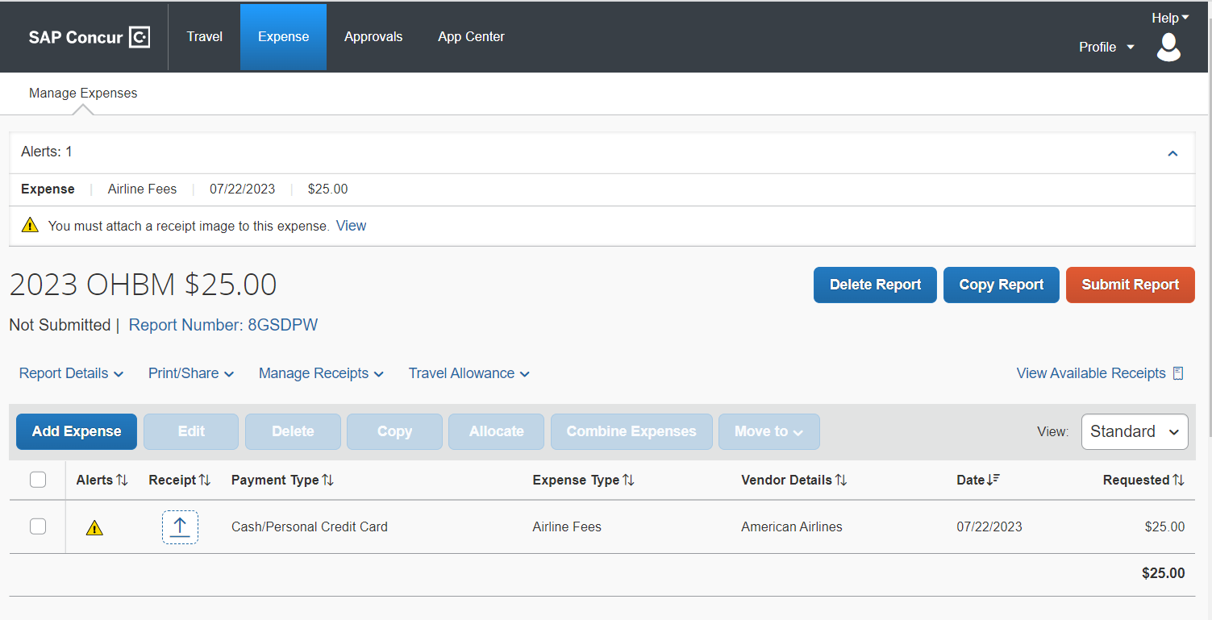
ATTACHING RECEIPTS + OTHER DOCUMENTATION TO YOUR EXPENSE REPORTS
1
Notes:
The system warns you that you have not attached your receipt. Do not submit without the receipt attached, or completing the affidavit of “Missing Receipt Declaration”.

Slide 8
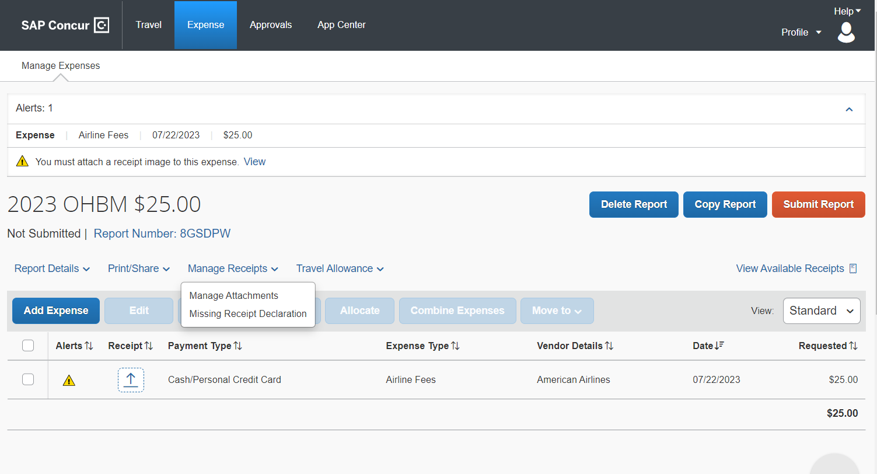
ATTACHING RECEIPTS + OTHER DOCUMENTATION TO YOUR EXPENSE REPORTS
2
Notes:
Under “Manage Receipts”, upload a copy of the conference program/meeting agenda.

Slide 9
Travel & Expense Reports (TER)
Penn Travel: Example present/attend a conference
The PI/Acct owner emails the trainee/staff that their travel expenses will be direct-paid and reimbursed with CC 10Admin-Fin@; provide these 4 pieces of info:
(1) Acct to charge: 400-4###-#-######-xxxx-####-#### [insert “fund” nickname]
(2) Business Purpose: Attend [conference, location] and present study findings.
(3) Total Amount: $$$-$$$$ / actual
(4) Costs covered: Registration fee; RT airfare (prepaid thru Penn); ground transportation; accommodation [DATES]; meals [DATES]
Next Steps:
Trainee/staff contacts 10Admin-Fin@ to indicate intent to reserve flight via Concur at least 2 months prior to conference.
Trainee/staff may request Penn purchasing card for registration fee to be paid direct. *All should have registration fee paid during “early-bird” discount period.*
Trainee/staff makes their accommodation reservation direct thru conf room block. This cannot be prepaid direct by Penn.
After travel has completed, trainee/staff creates an Expense report in Concur and submits for reimbursement.
Notes:
Scenario: Present/attend a conference for which the PI/Acct owner has allocated funds to support the travel expenses.
Advanced planning:
The PI/Acct owner emails the traveler that the expense will be direct-paid and reimbursed with CC 10Admin-Fin@; provide these 4 pieces of info:
(1) Acct to charge: 400-4###-#-######-xxxx-####-#### [insert “fund” nickname]
(2) Business Purpose: Attend [conference, location] and present study findings.
(3) Total Amount: $$$-$$$$ / actual
(4) Costs covered: Registration fee; RT airfare (prepaid thru Penn); ground transportation; accommodation [DATES]; meals [DATES]
This allows for full transparency to allow the trainee/staff to plan effectively. And limits how many questions 10Admin-Fin@ will ask!
Next steps:
Trainee/staff contacts 10Admin-Fin@ to indicate intent to reserve flight via Concur at least 2 months prior to conference.
Trainee/staff may request Penn purchasing card for registration fee to be paid direct. *All should have registration fee paid during “early-bird” discount period.*
Trainee/staff makes their accommodation reservation direct thru conf room block. This cannot be prepaid direct by Penn.
After travel has completed, trainee/staff creates an Expense report in Concur and submits for reimbursement.

Slide 10
Travel & Expense Reports (TER)
There is the large-wide format printer at 10 Gates!
Example: Poster printing
Accepted abstract needs to be printed for a conference/other event thru the Biomed Commons.
The PI/Acct owner emails the trainee/staff that the fee(s) will be paid directly, with CC 10Admin-Fin@; provide these 4 pieces of info:
(1) Acct to charge: 400-4###-#-######-xxxx-####-#### [insert “fund” nickname]
(2) Business Purpose: Poster printing at Biomed Commons.
(3) Event: [Conference, location, dates].
(4) Total Amount: $$-$$$
Trainee/staff submits ticket to Biomed Commons, inserting 10Admin-Fin@ address for internal payment confirmation.
10Admin-Fin receives request and confirms payment processing within Biomed Commons portal.
Notes:
For use of the 10-GATES wide-format printer: Please contact Andrew Zitelli and Kosha Ruparel at least 3 business days in advance to ensure the printer and staff are available.

Slide 11
DIRECT BILL: Concur/World Travel
Penn Business Traveler
The PI/Acct owner has sent their approval that the expense is being covered.*
*Traveler: Make sure your personal profile is up-to-date.*
Insert in “notes to approver” the account to charge.*
Provide the Penn business purpose (examples):
-Present data/study findings
-Collaborate w/ colleagues/partners
-Participate in scientific conf
-Attend mandatory sponsor/study site visit
10Admin-Fin@ has 24 hours to approve for the reservation to ticket.
Notify 10Admin-Fin@ of intent to post an airfare reservation in Concur (Monday-Thursday only).
Notes:
Amtrak – Procard thru dept or pay out of pocket and be reimbursed. If booked direct-bill via Concur, an additional $25 service charge is levied per ticket! RT = $50!!!

Slide 12
Travel & Expense Reports (TER)
Penn Business Traveler
You/your expense delegate creates a new expense report in Concur.
*Make sure your personal profile is up-to-date; including banking info.*
Insert in the Report Header the account to be charged + all other pertinent info (see next slide examples) in notes section
…and a business purpose (justification):
Present data/study findings
Collaborate w/ colleagues/partners
Participate in scientific conf
Attend study site visit
If all is accounted for (copy of agenda/ program; itemized receipts; etc.), then submit!
You may request a preview of your report to 10Admin-Fin@ prior to submission

Slide 13
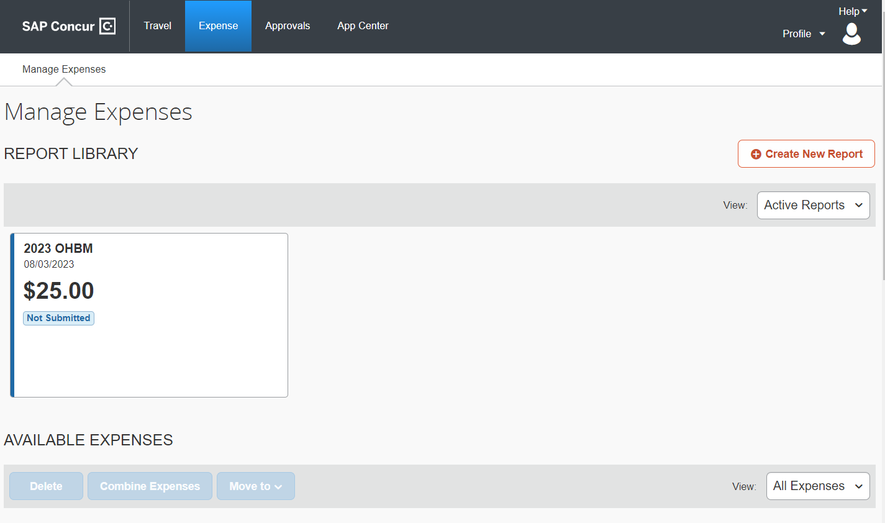
EXAMPLE: “CREATE NEW REPORT” SCREEN

Slide 14
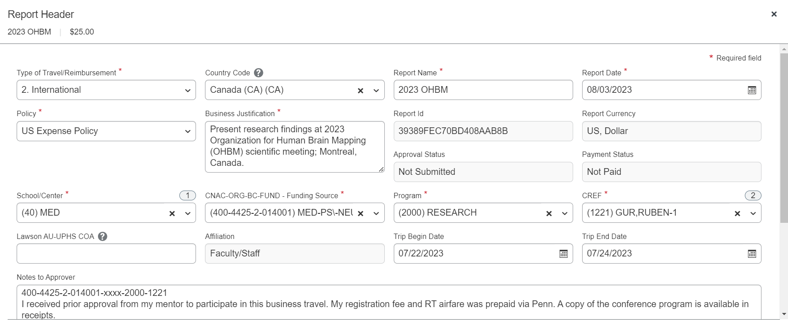
EXAMPLE: REPORT HEADER (first data screen completed when you “Create New Report”)
Notes:
Be sure to add the funding source and business justification to the report header

Slide 15
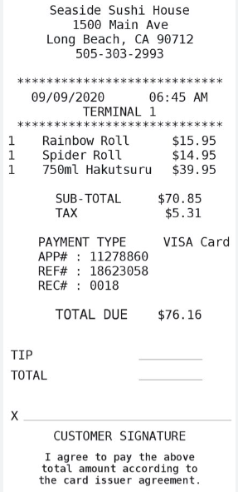
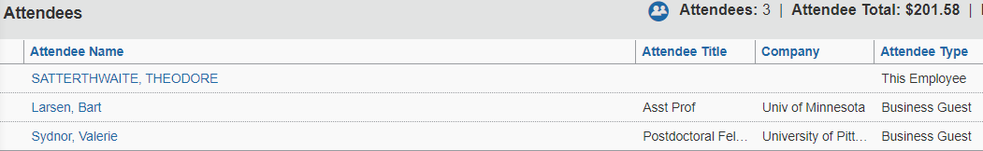
Business Lunch/Dinner (TER)
Example of Business Meal Report Entry:
Requesting a business lunch/dinner expense must include the following: itemized receipt of meal, adding the attendees and their affiliation to the list provided in concur. In addition, the department is requesting that a comment totaling the receipt (food+drink+tax+tip=total) be added to the report.

Slide 16
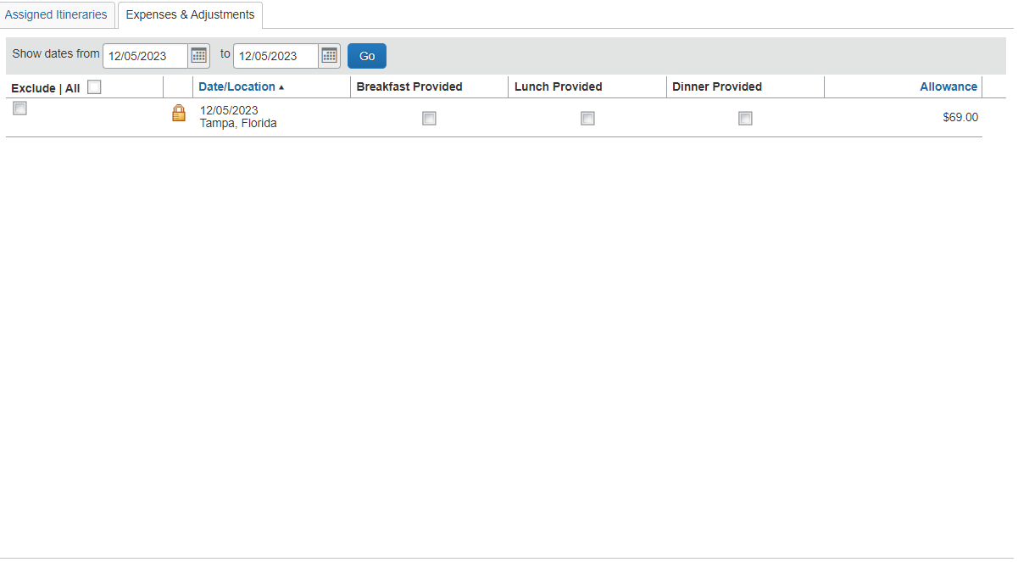
Business Lunch/Dinner (TER)
Example of Business Meal Report Entry:
If you attend a business lunch or dinner that is being requested and/or re-imbursed on another traveler's expense report, you must adjust the per diem to include that the meal was “provided”. In Concur, this is also called a “Travel Allowance”.

Slide 17
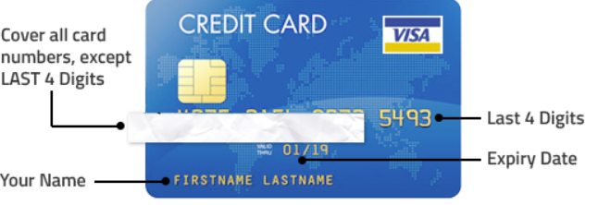
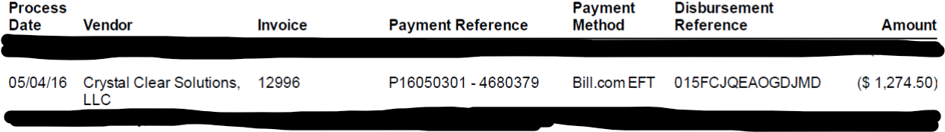
Travel & Expense Reports (TER)
Additional Requirements:
Documenting proof of payment per transaction:
All detailed receipts must include your name and the last 4 digits of your payment method on the receipt.
IF the invoice is in the name of someone different than who is requesting the reimbursement proof of payment is required. (e.g. a screenshot of the front of your credit card with the numbers blacked out excluding the last 4 digits or a copy of your bank/credit card statement showing the transaction with all other transactions blacked out

Slide 18
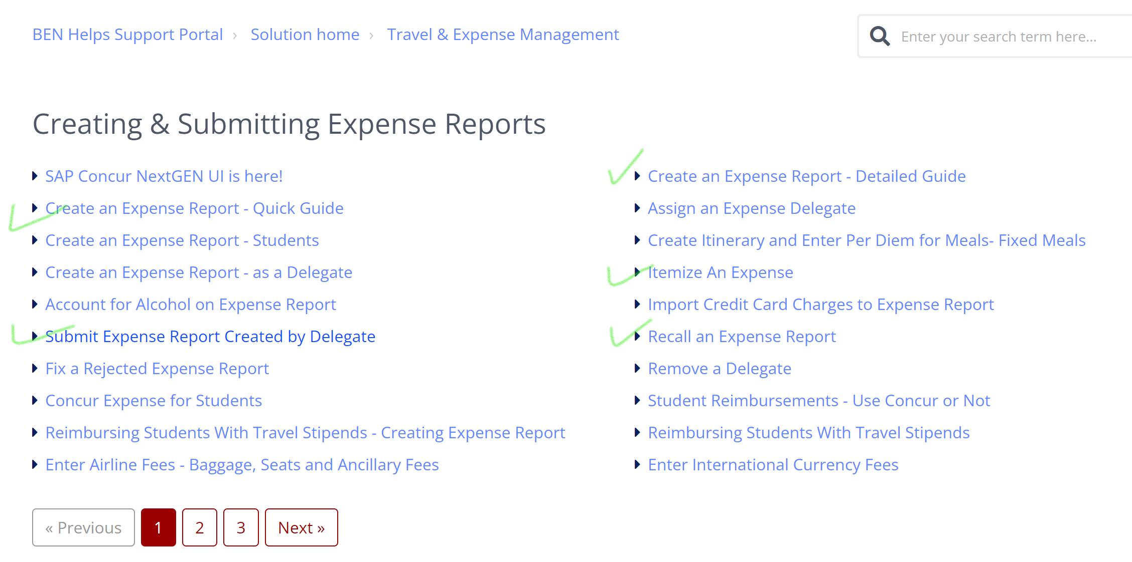
Resources and guides available to you (PennKey required): https://benhelps.upenn.edu/support/home

